Slide 1

Electronic Documentation/BMV Training
For
Nursing Students and Instructors
Tammy Galindo MSN/ed, RN
Education Coordinator

Slide 2

Mission Statement
Madera Community Hospital is a not-for-profit community health resource, dedicated to actively promoting and maintaining the health and wellbeing of residents throughout the Central Valley. We are committed to identifying and serving our community’s needs with compassion, concern, care, and safety for the individual.

Slide 3

Welcome Students/Instructors to MCH!
MCH staff pride themselves in facilitating an environment that is safe, collaborative, and beneficial to learning. The goal of this presentation is to provide students and instructors with the knowledge of electronic documentation and bedside medication verification (BMV), to ensure a successful and safe learning experience at MCH.
The following slides will identify safety rules, the process of logging into the Network and Meditech, documenting patient care, reviewing past documentation, and medication administration using BMV. Throughout the presentation, click the mouse or tap the downward arrow key to advance to the next slide.

Slide 4

Safety Rules
**All students must receive verbal permission from the patient to assist in their care, and document the permission**
Access medical records on a need to know basis only
Never leave an open screen unattended
Always log off before walking away
Remember to keep the WOW plugged in when not in use
NEVER share your password with anyone
All student documentation must be co-signed
NEVER document interventions before carrying them out
Record observations of behavior rather than your interpretation of the behavior

Slide 5
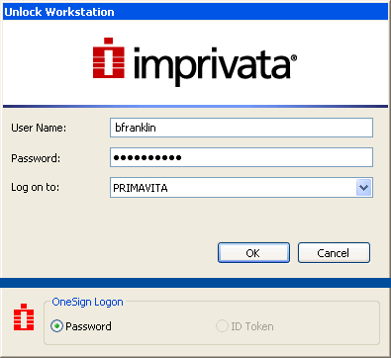
Logging into the Network
Enter your Network Username and temporary Password provided by MCH and click OK. You will be prompted to create a permanent password and asked to set up 5 security questions. The security questions are in place in case you forget your password when logging into the Network.

Slide 6
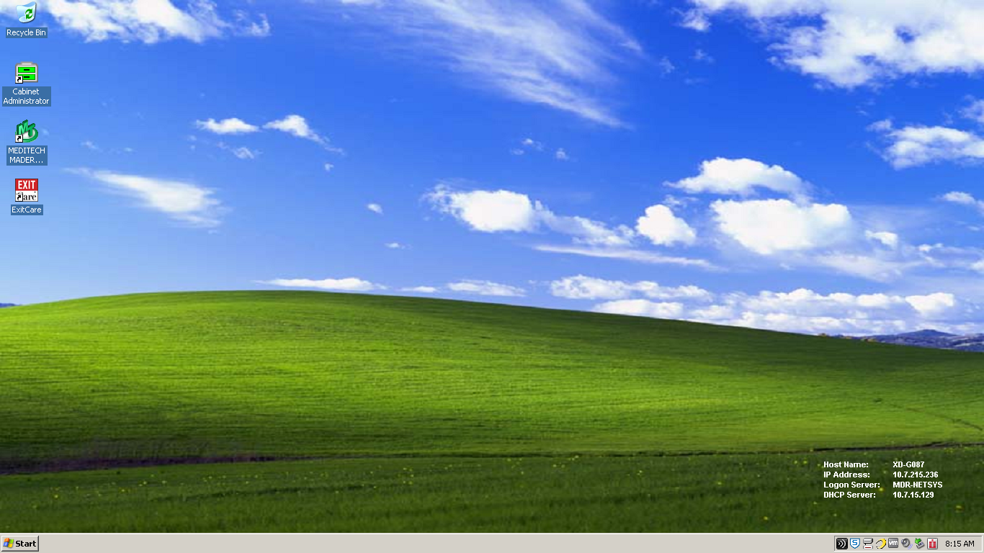
Logging into Meditech
Double click the Meditech icon

Slide 7
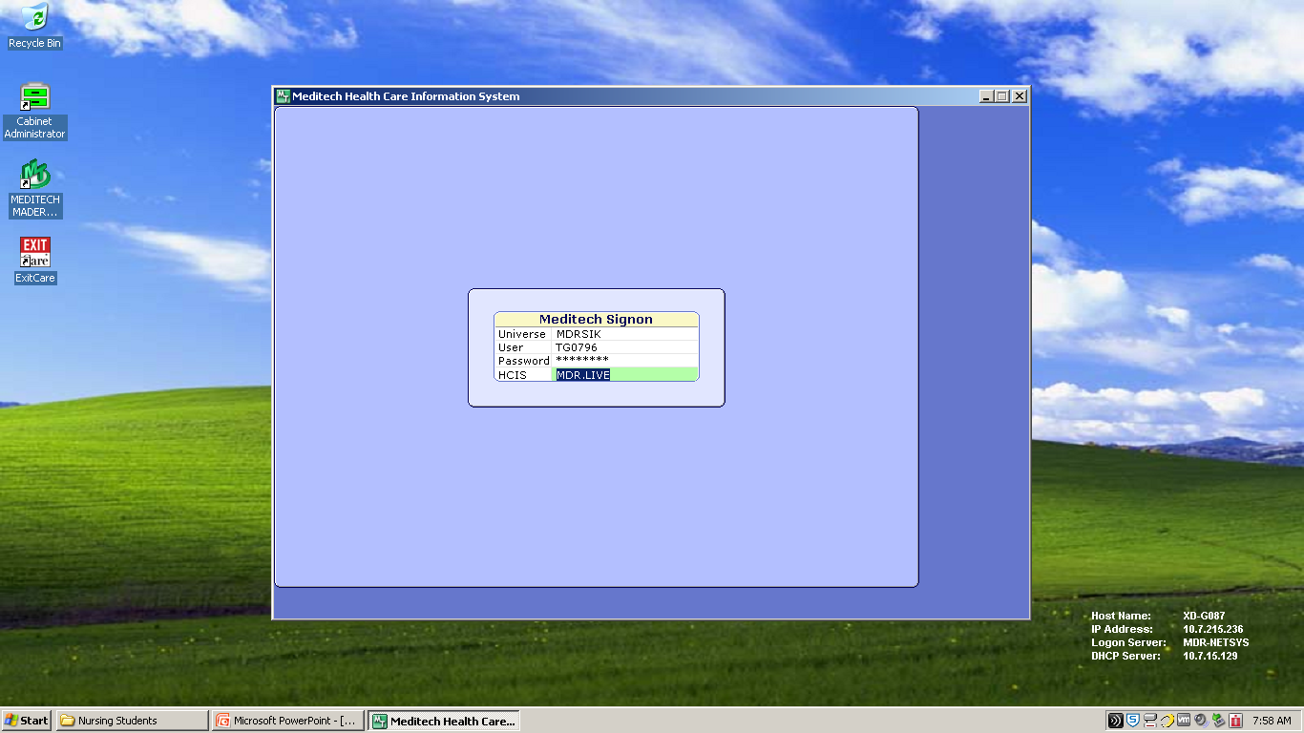
Meditech Sign-On
Type in your Meditech Username and Password provided by MCH
Tap the Enter key when done
.

Slide 8
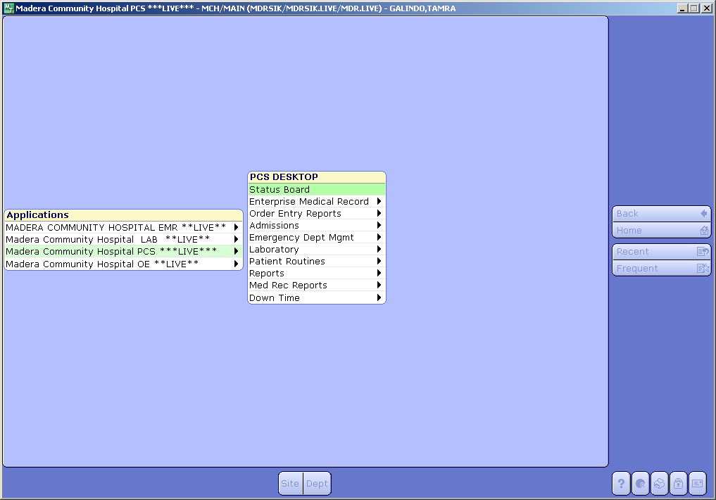
Logging into Patient Care Services (PCS)
Click on PCS Live and then on Status Board

Slide 9
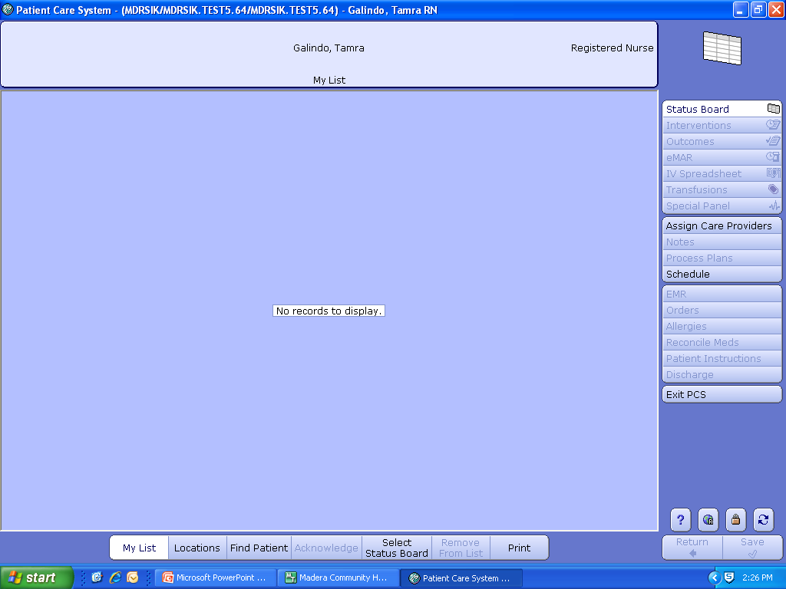
Creating Your Patient List
Click on Find Patient

Slide 10
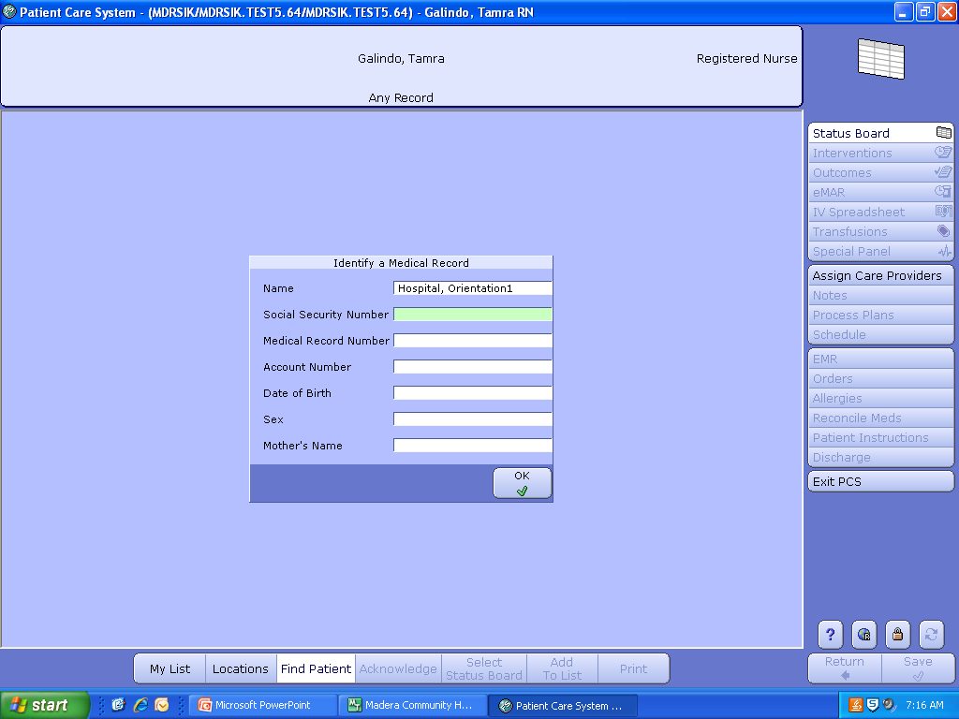
    Patient Look Up
    Enter the patient’s last name first, first name last.
    Click OK when done.

Slide 11
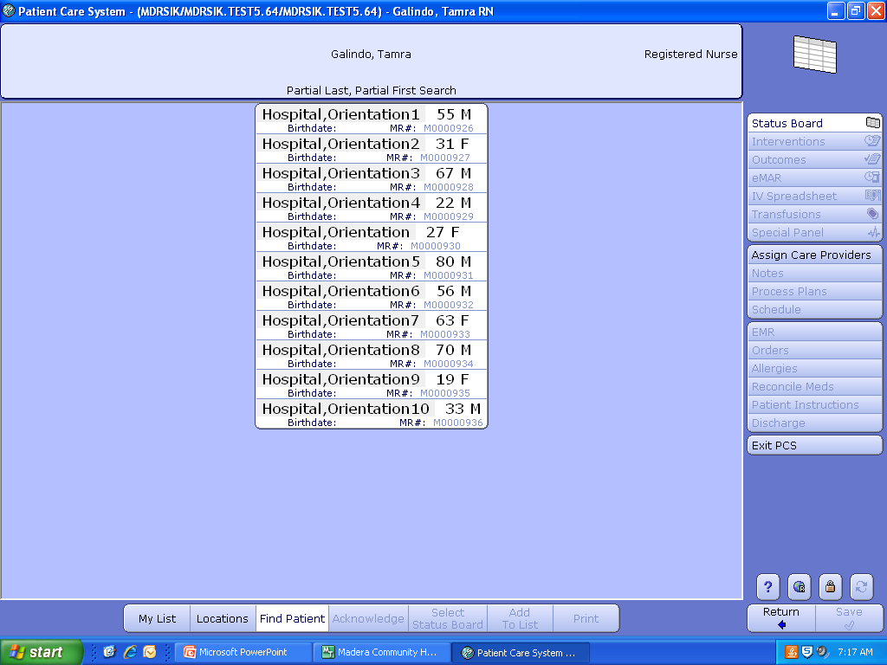
Click on the Patient’s Name

Slide 12
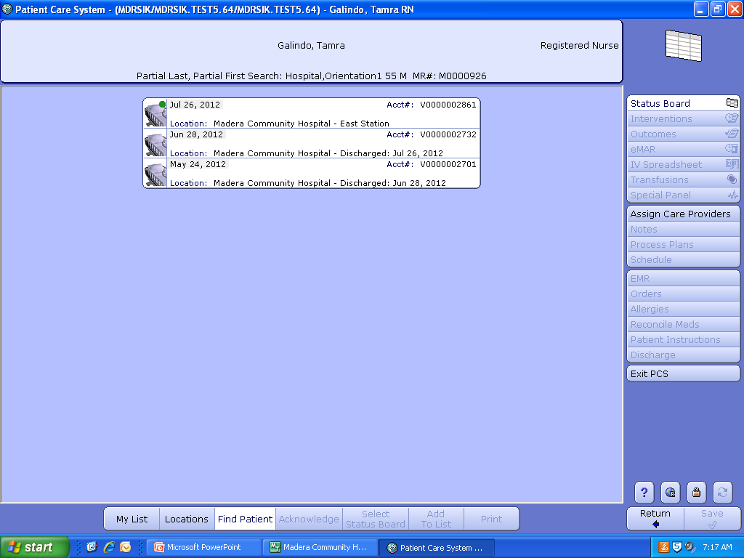
    Click on the Visit with the Green Dot
Different icons may appear on this screen depending on the type of visits your patient has had.
Icons
Gurney=Hospital admission
Ambulance=ED visit
Thermometer=Laboratory visit
Magnifying Glass=Observational visit

Slide 13
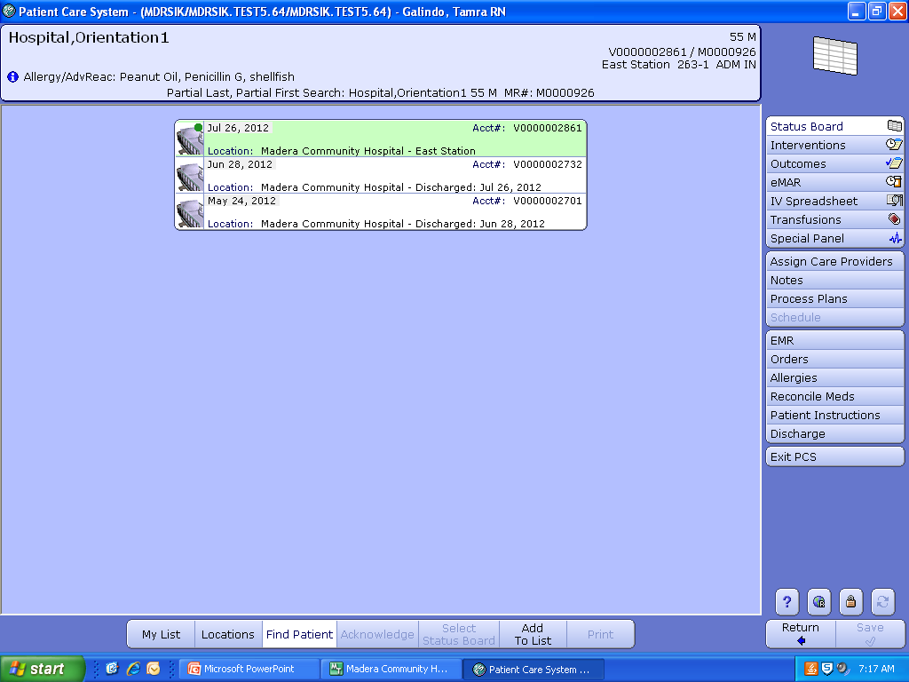
    Click Add to List and then Click My List

Slide 14
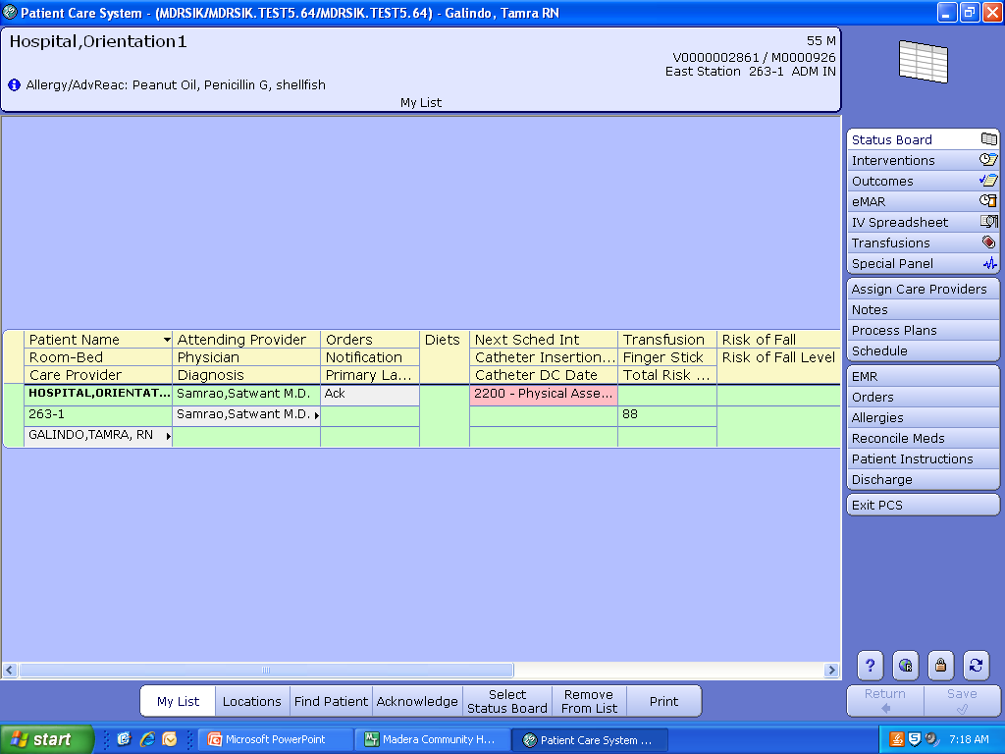
  Status Board
  Information available on the status board includes patient name, room number, physician name(s), diagnosis, and items continually monitored (e.g. orders, fingersticks, tele, fall risk, isolation, etc.)

Slide 15
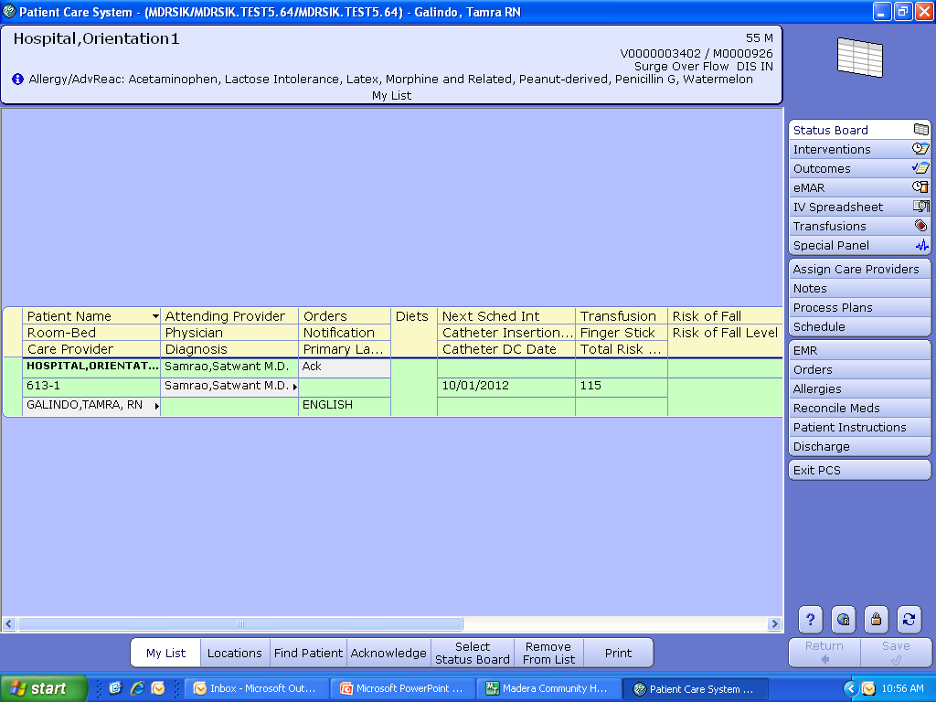
Integrated Desk Top
The integrated desk top (column to the right) contains tabs that allow you to document interventions, view results, and view what has been documented
Interventions= Document assessments, patient care
Outcomes= Document whether goals have been met or not
eMAR= Document medication administration
IV Spreadsheet=Document IV fluid intake and rate
EMR=View all patient data and care provider documentation

Slide 16
Patient Care Documentation
Click on the Interventions tab on the integrated desk top

Slide 17
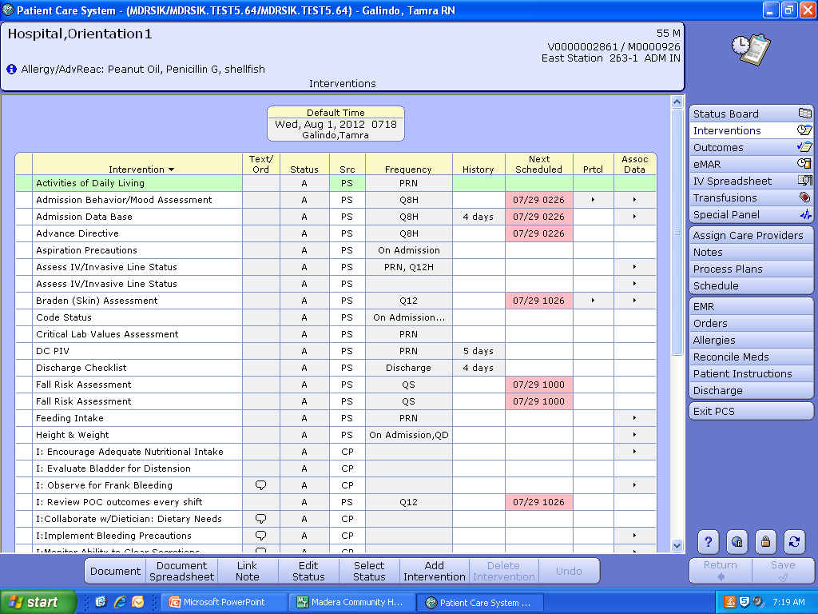
Documentation is in “Real Time”
Double click the intervention you are wanting to document on (e.g. Activities of Daily Living). Document the intervention and click Save.

Slide 18
Interventions to Document
The interventions listed in red are how they appear on the intervention list
Physical Assessment= head to toe physical assessment
Braden (skin) Assessment= skin assessment
Fall Risk Assessment= risk of fall assessment
IV Start= IV insertion
DCIV/Invasive Line= discontinuing an IV
Vital Signs= vital signs
Pain assessment (stand alone)= pain
Intake and Output= fluid intake and output
Urinary Catheter Assessment= urinary catheter insertion, shift assessment, irrigation, and removal
Gastric Tube Insertion/Assessment= gastric tube insertion, assessment, and removal
Feeding Intake= meal intake (breakfast, lunch, dinner, and supplements)
Wound Assessment= wound assessment and dressing changes

Slide 19
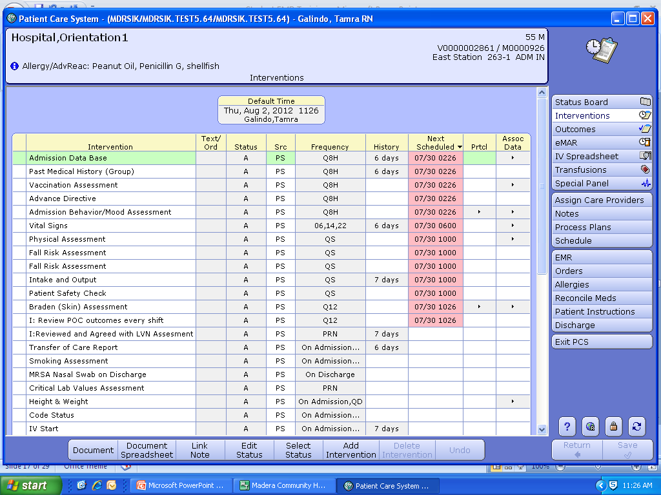
Students must receive verbal permission from the patient to assist in their care, and document the permission.
Click on Add Intervention

Slide 20
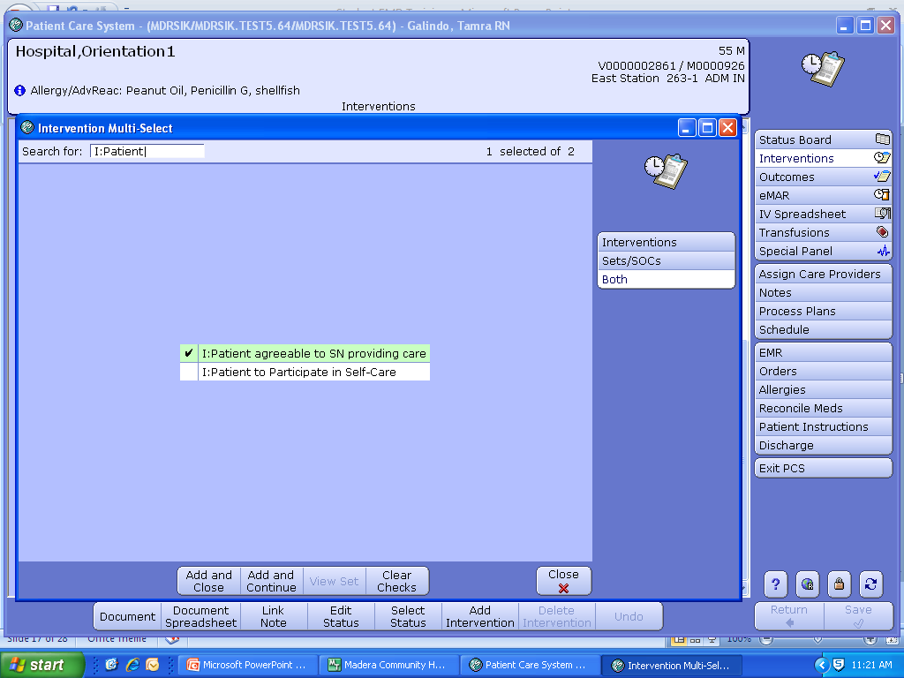
Type I: Patient in the search box. Click on the square to the left of the I:Patient agreeable to SN providing care intervention, a check mark will be placed. Click on Add and Close button.

Slide 21
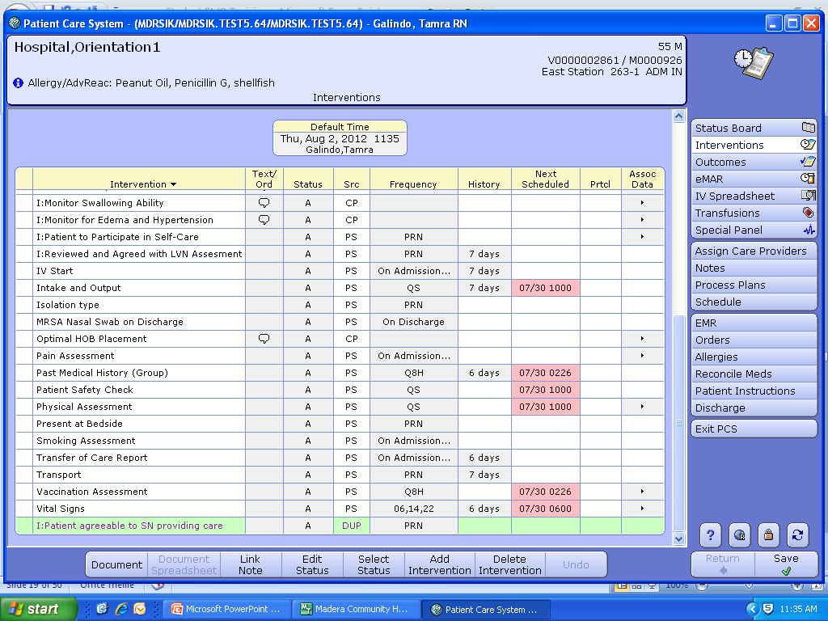
The I:Patient agreeable to SN providing care intervention will appear in purple on the intervention list. Double click the intervention and click Save.

Slide 22
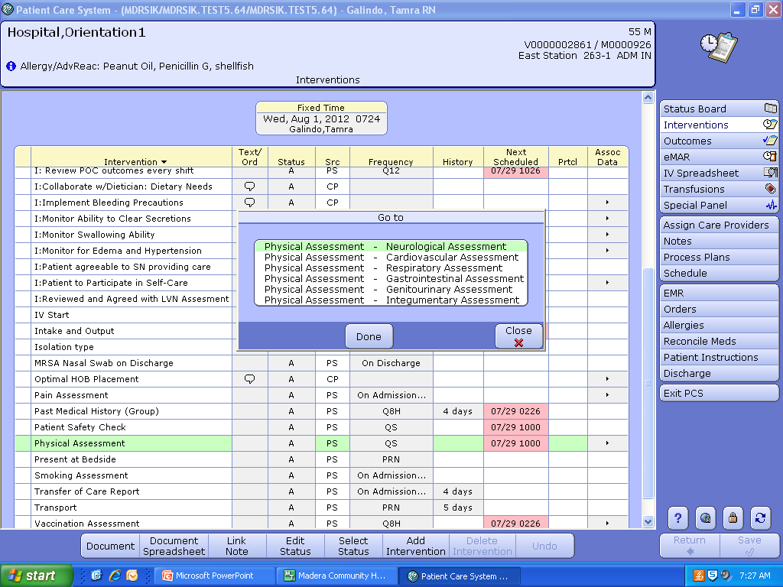
Documenting a Physical Assessment
Double click on Physical Assessment, each body system is listed individually

Slide 23
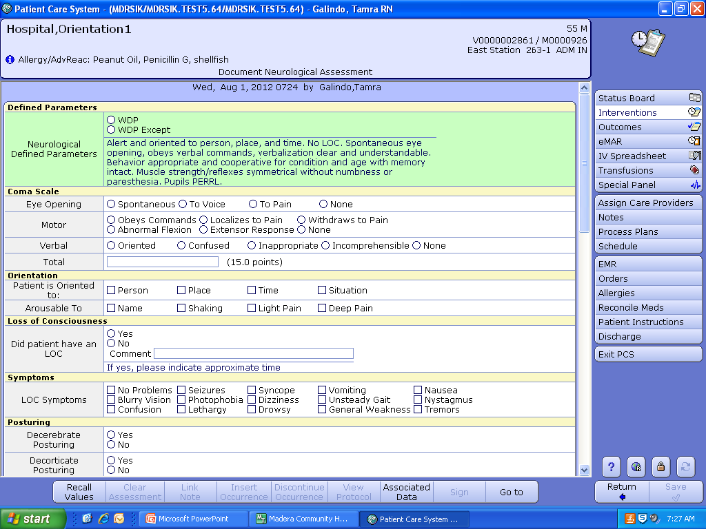
Charting by Exception on Physical Assessments
Click WDP (Within Defined Parameters) if the patient assessment matches the defined parameters listed in blue. Click WDP Except if the patient assessment does NOT match the defined parameters listed.
If you click WDP Except, only document the area(s) that are NOT within the defined parameters

Slide 24
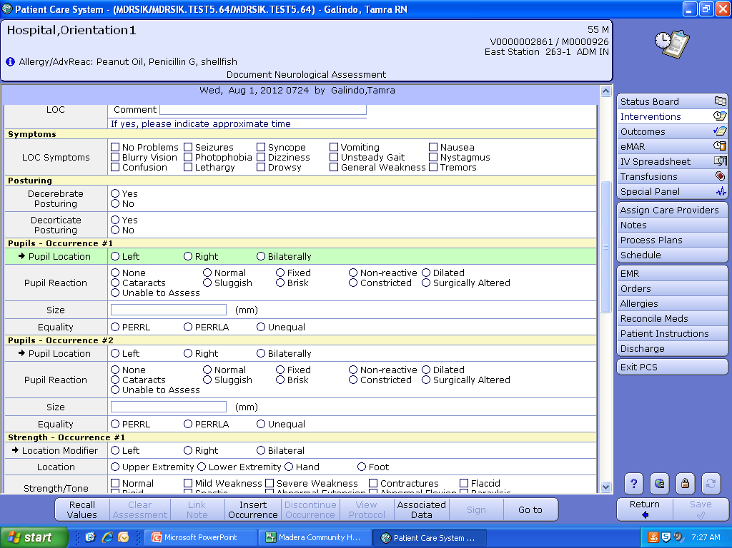
Documenting a Repeatable Assessment/Intervention
To document repeatable items; e.g. IV’s, pupils, pulses, teaching, etc. Click on Insert Occurrence (footer button) and Occurrence #2, #3, etc. will appear.
For example: Pupils-Occurrence #2 has been added

Slide 25
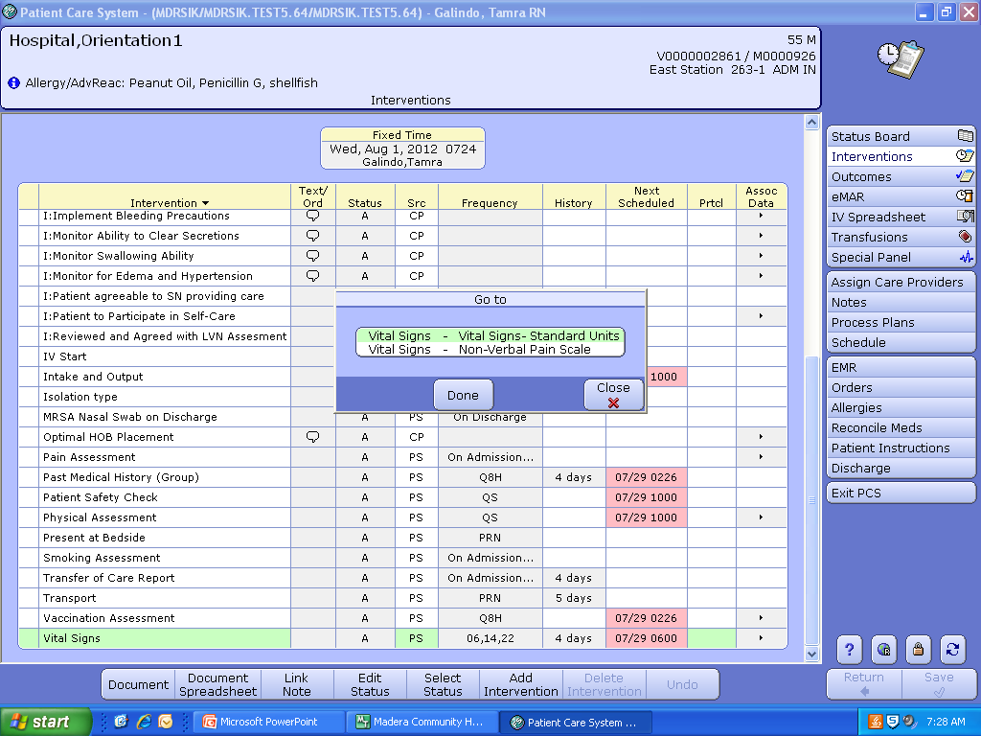
Documenting Vital Signs
Double click Vital Signs intervention, click Vital Signs-Standard Units, and click Save when done.

Slide 26
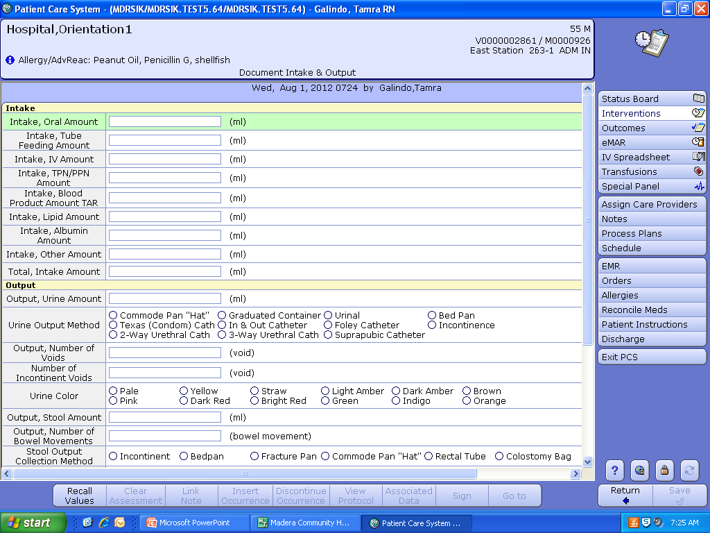
Documenting Intake & Output
Double click on the Intake and Output intervention and enter the patient’s Intake and/or Output. Click Save when done.
The Intake and/or Output entered automatically transfers to the I & O in the EMR
Intake from a patient’s tray does not get entered here (enter on the Feeding Intake intervention)

Slide 27
Charging for Supplies
Please charge for new supplies as they are used.
Charges are built into each intervention.
Ask for assistance from your instructor or RN Team Leader if you have questions about chargeable items

Slide 28
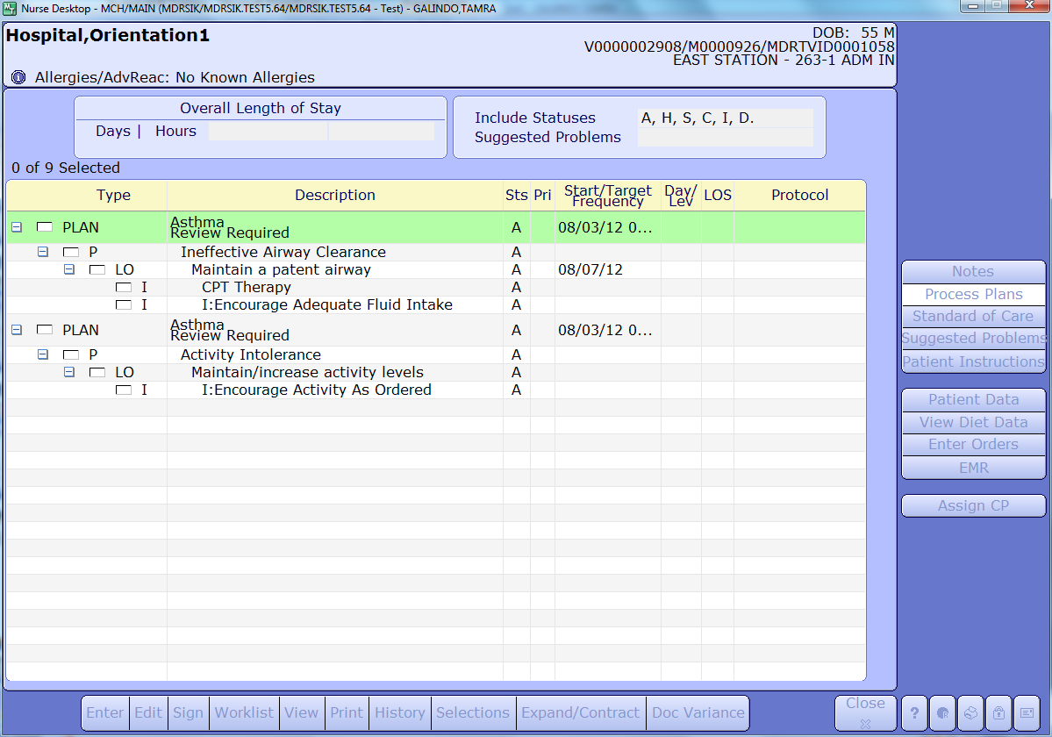
Care Plan
To view the Plan of Care (POC) click on Process Plans or Outcomes on the integrated desk top
The patient’s plan of care is reviewed every 12 hours. The plan of care lists the problem, long term outcomes, and interventions for a specific diagnosis (i.e. asthma) or suggested problem. The plan of care is revised every 72 hours, or earlier if needed.

Slide 29
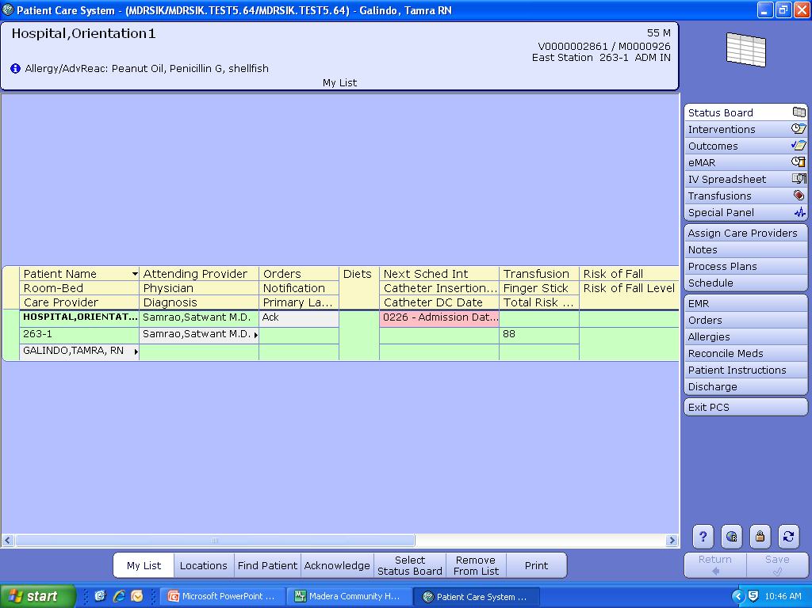
EMR (Enterprise Medical Record)
Click on EMR to “view only” patient VS, I & O, medications, order history, lab, microbiology, blood bank, pathology, imaging, ER notes, history and physical, care trends, and medication reconciliation.

Slide 30
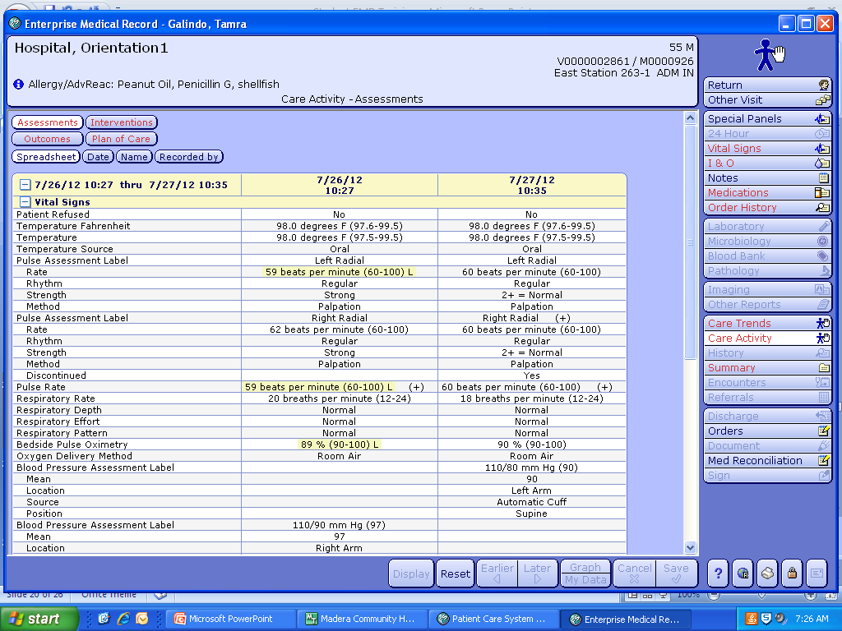
Click on Care Activity tab to view a summary of the care documented during hospitalization.
This is a great tool for hand-off report. Remember to use SBAR

Slide 31
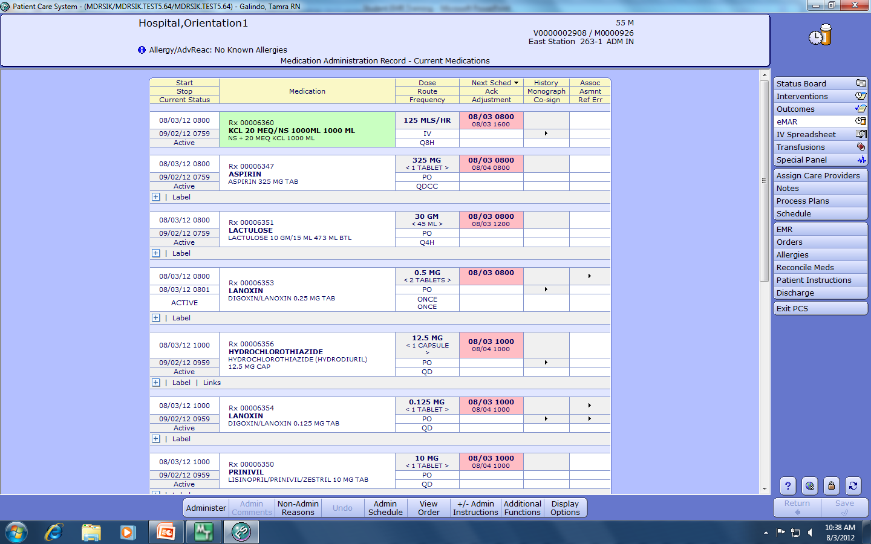
Bedside Medication Verification (BMV)
**Always follow the 6 Rights of Medication Administration**
Click on eMAR from the integrated desk top. You will use a hand held scanner attached to the WOW to scan your patient’s wrist band and medications.
Monograph-where to look up drug info.
6 Rights of Med. Admin.
1. Right patient
2. Right med.
3.Right dose
4. Right route
5. Right time
6.Right to refuse

Slide 32
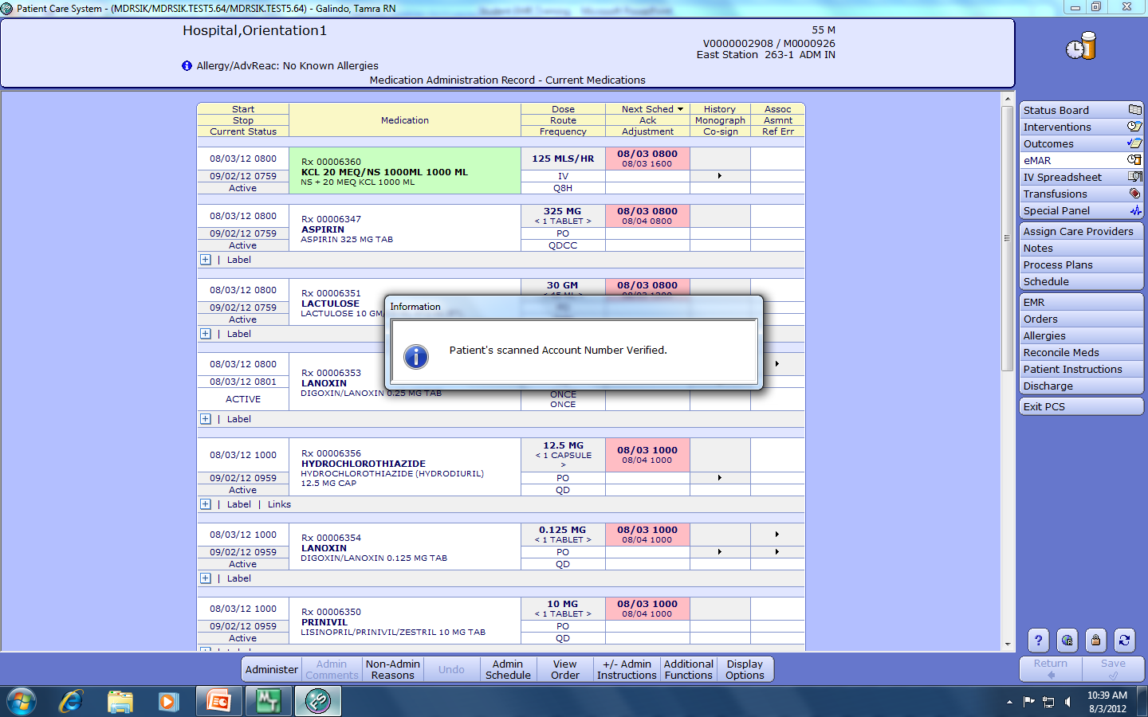
Bedside Medication Verification (BMV)
With your instructor or RN Team Leader at bedside scan the patient’s wrist band with the hand held scanner, compare the patient’s name and medical record number from the wristband against the eMAR, check for allergies, and medication expiration date. A confirmation box will appear in the middle of the screen.
Always tell the patient
Name of Medication
What it is used for
Why he or she is receiving it
Possible side effects

Slide 33
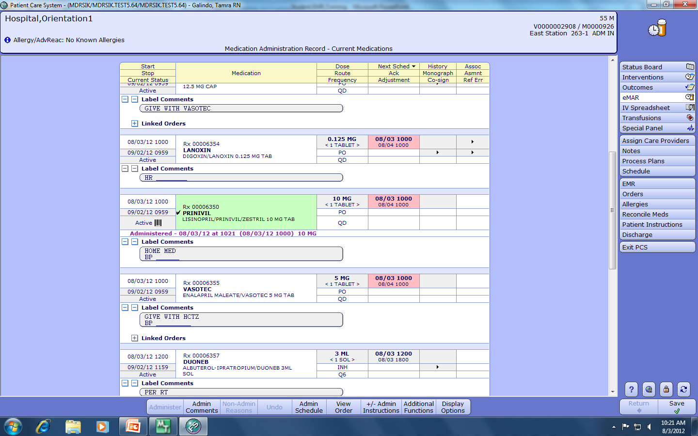
Double check the patient’s name, name of the medication, dose, route, and scheduled time of the medication before scanning it. Administered-date, time, amount will appear below in purple. Click Save when done.
A bar code appears after the medication has been scanned

Slide 34
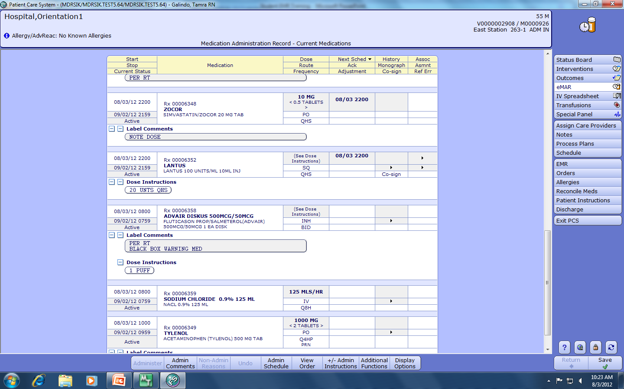
**High-Risk Meds Require a Co-Signer**
Insulin is an example of a high-risk med and the word Co-sign appears

Slide 35
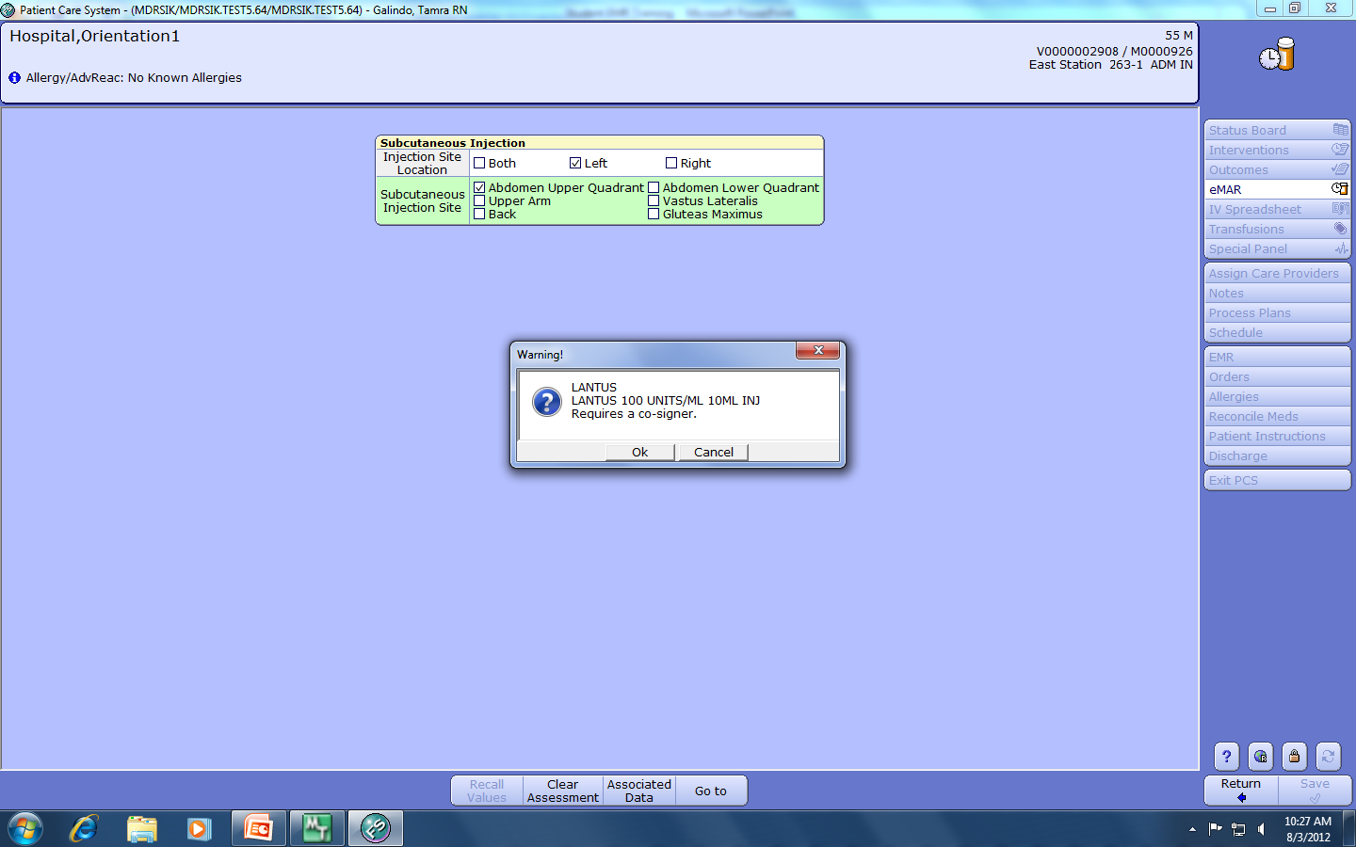
Documenting Insulin Administration
After entering injection site information, a prompt for a co-signer will appear. Two licensed nurses will need to verify the blood sugar amount, sliding scale used, and amount and type of insulin drawn up.

Slide 36
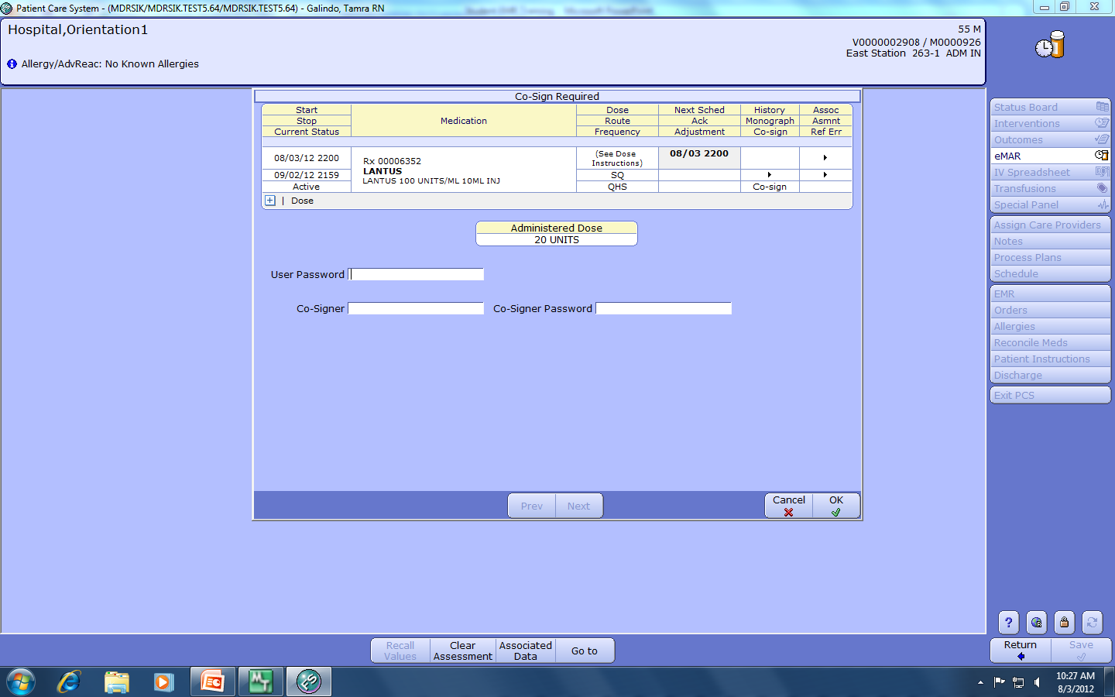
Co-Signer
The RN/instructor administering the insulin with the student enters his or her User Password in the top box. The licensed co-signer enters his or her User Name and Password in the Co-Signer boxes.

Slide 37
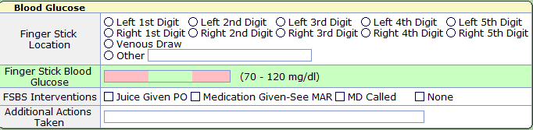
Documenting Fingerstick Blood Glucose Results
In addition to the eMAR, fingerstick blood glucose results are also documented on the FSBS intervention

Slide 38
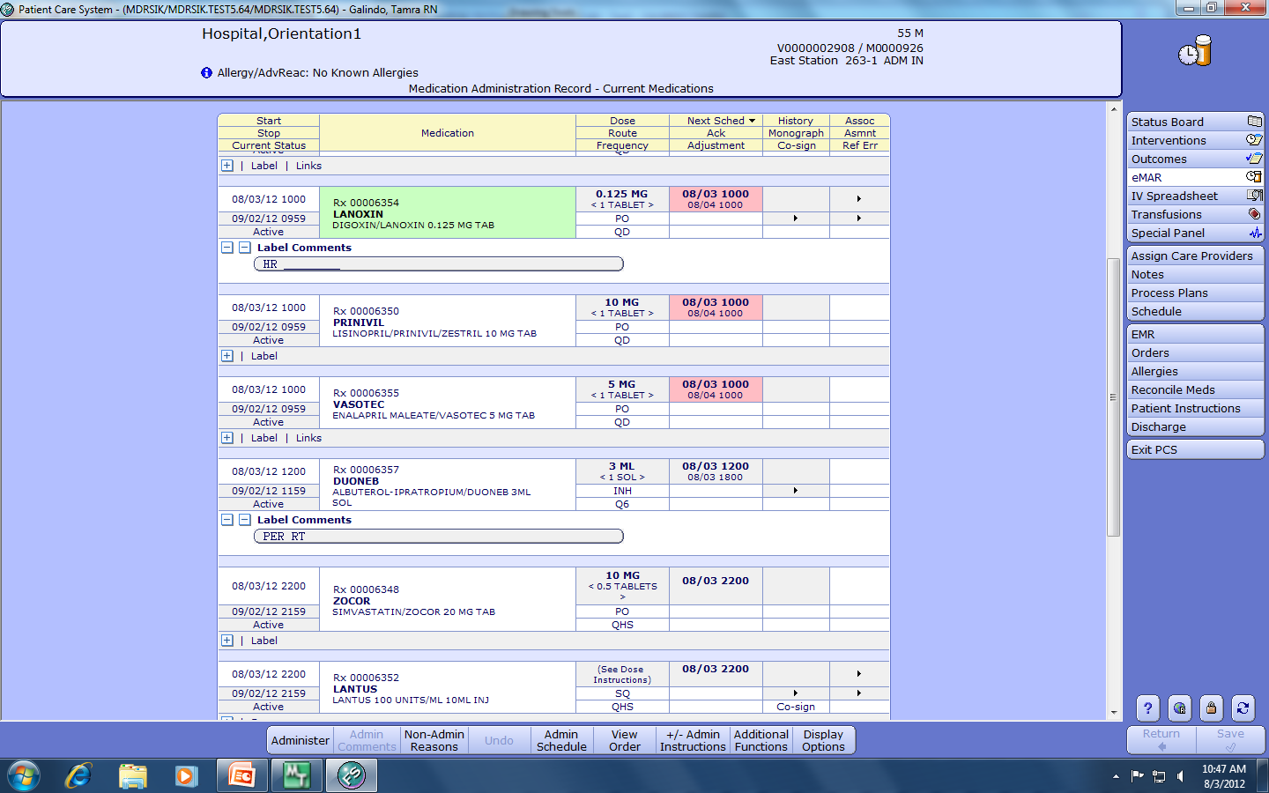
When a scheduled medication is not going to be given, click on Non-Admin Reasons to document

Slide 39
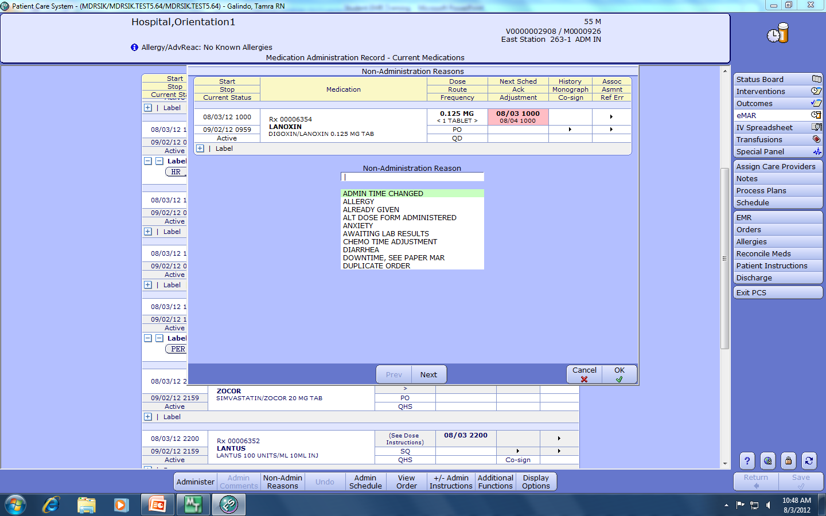
This screen will appear after clicking the Non-Admin Reasons button
You can free text the reason or scroll by clicking the Next button

Slide 40
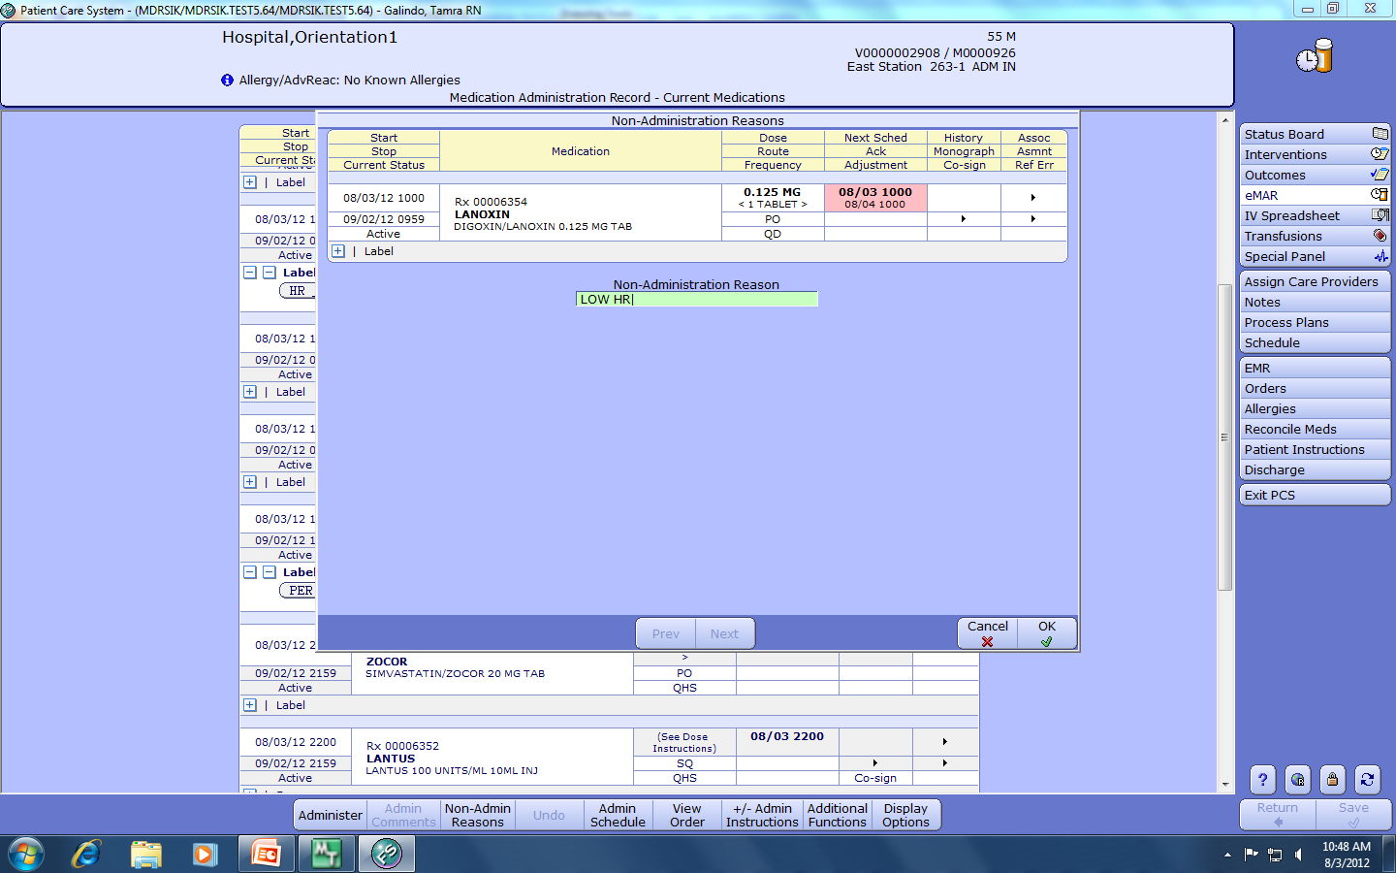
Select from the list of Non-Admin Reasons for why the medication was not given

Slide 41
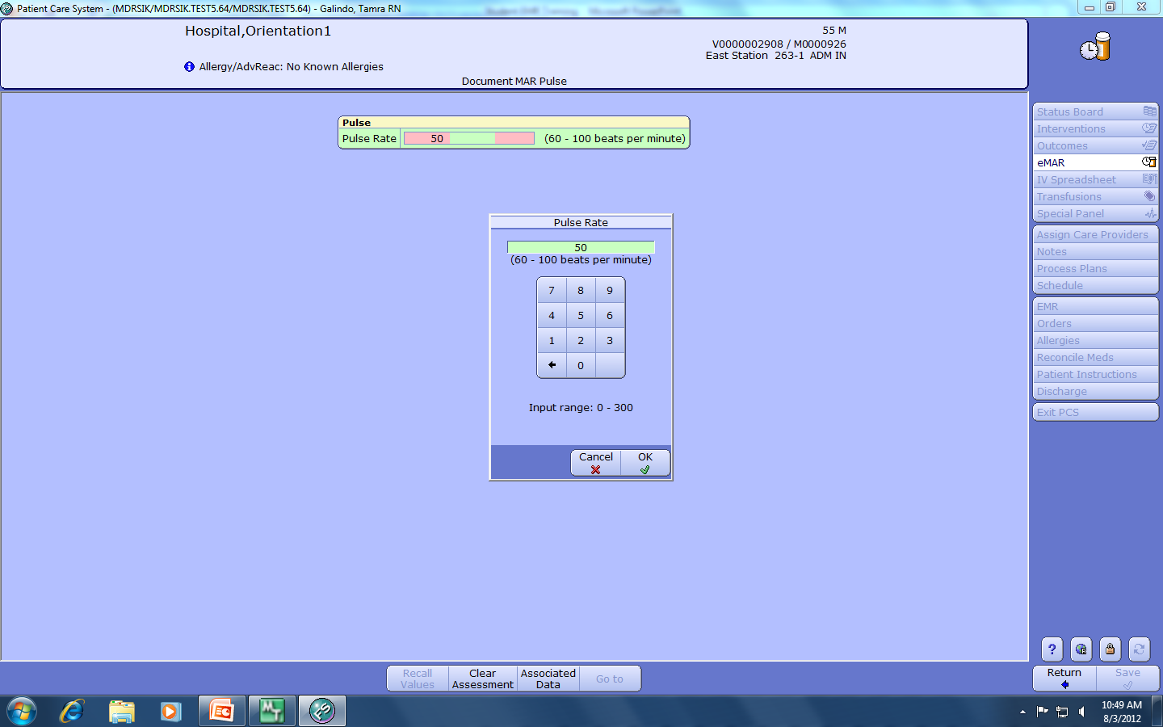
Enter additional information if needed/prompted to support why the medication was not administered
WARNING
The computer will not
alert you if the value is not
appropriate for administering
the medication. YOU are responsible for knowing lab results, vital signs , and parameters necessary to safely administer the medication.

Slide 42
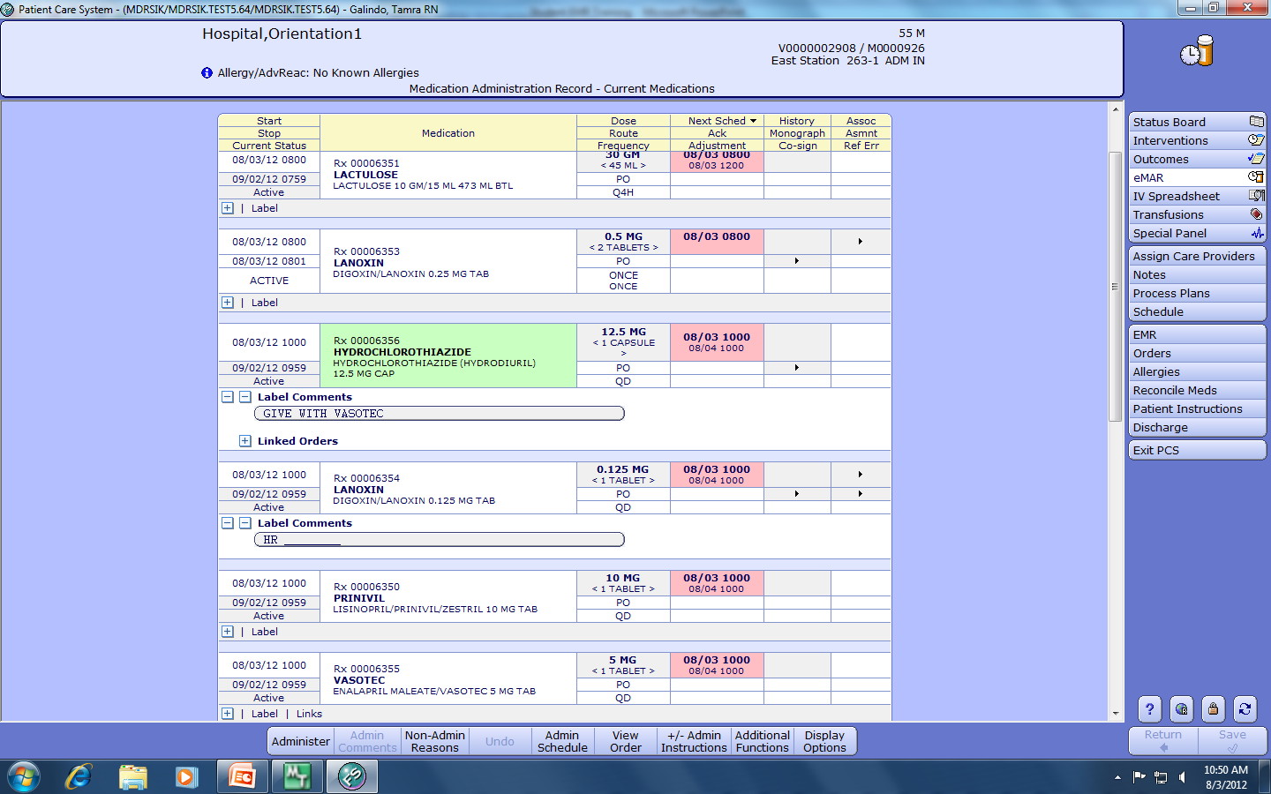
Linked Medications
Medications that are to be given together will have the words Linked Orders by Label Comments.

Slide 43
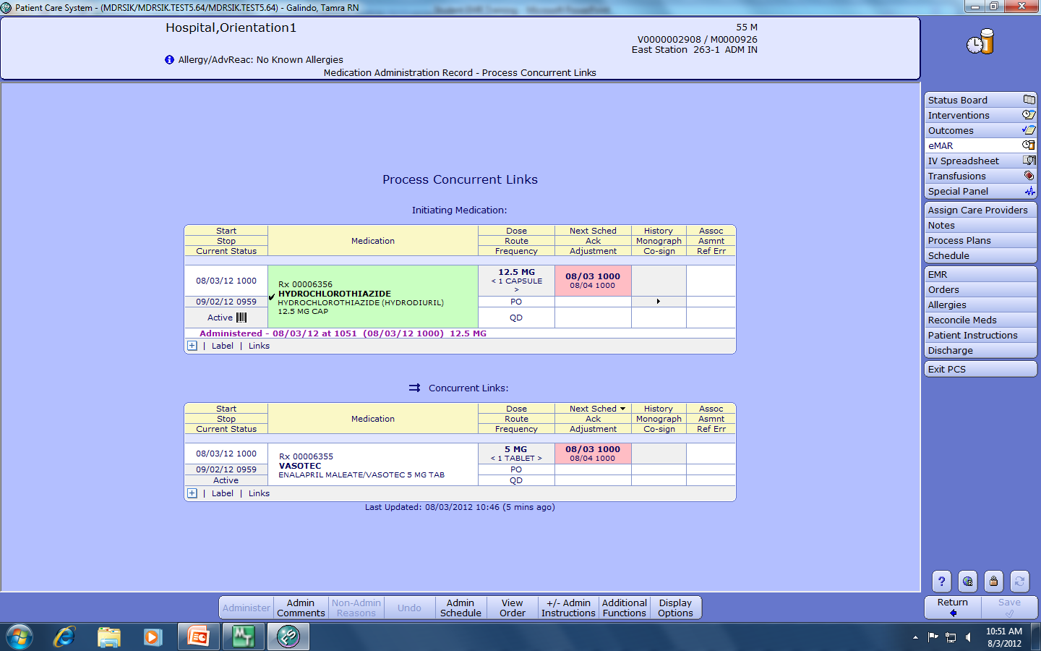
When the linked medication is scanned, the other medication that is to be given next will appear below it.

Slide 44
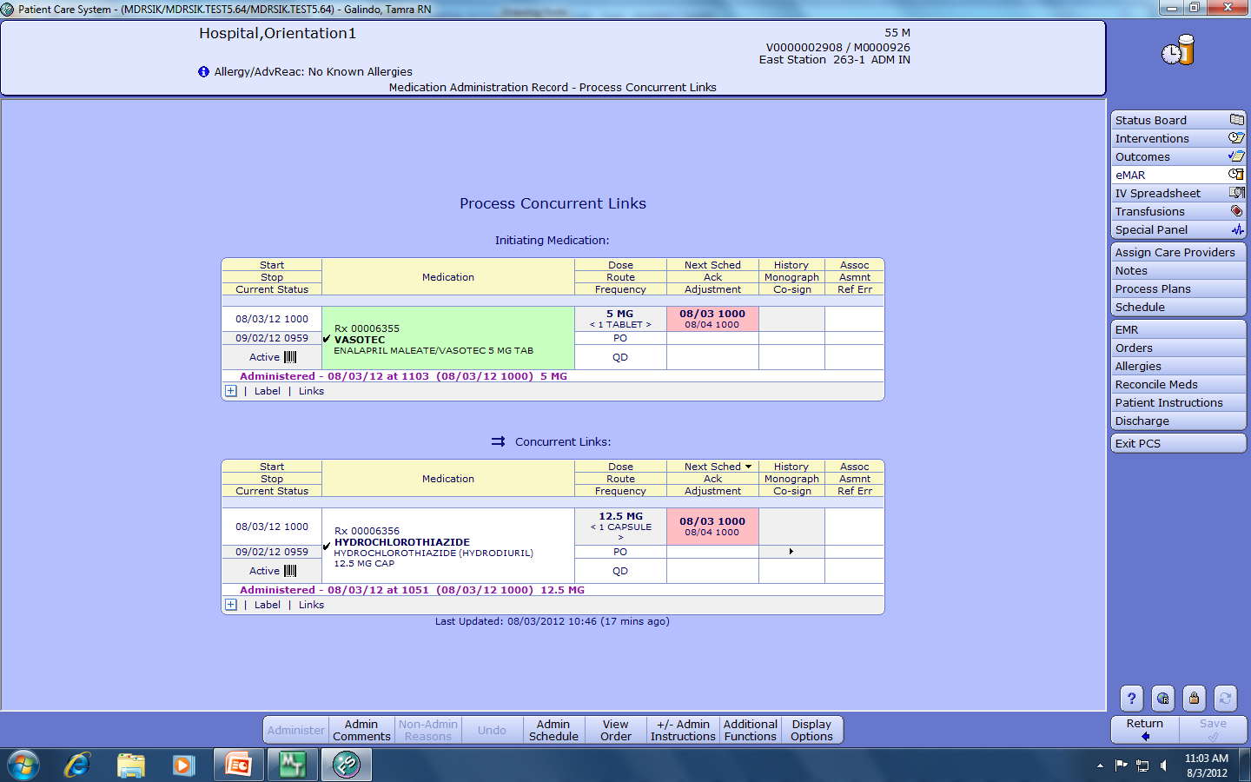
This screen appears after the second linked medication is scanned. Click Return to return to the eMAR.

Slide 45
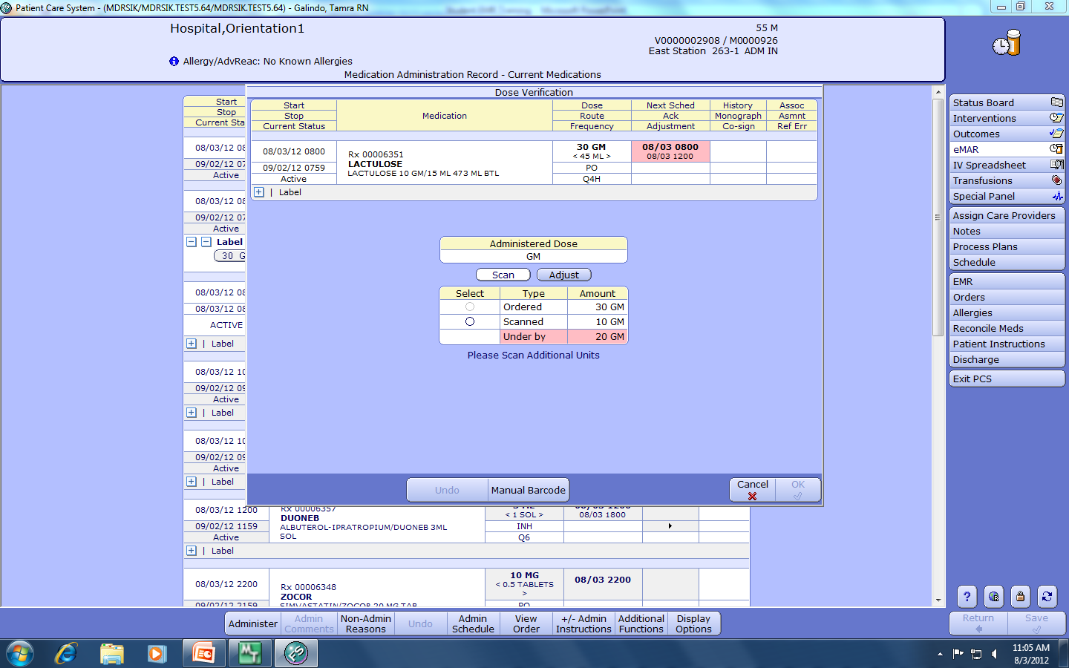
This screen appears when the dosage of the medication scanned is less or more than the ordered dose. The order is for Lactulose 30gm and the medication available is 10gm/15ml. You must scan 3 separate containers, you cannot scan one container 3 times.
The dosage is under by 20gm, you will need to scan two additional containers. Note the pink color.

Slide 46
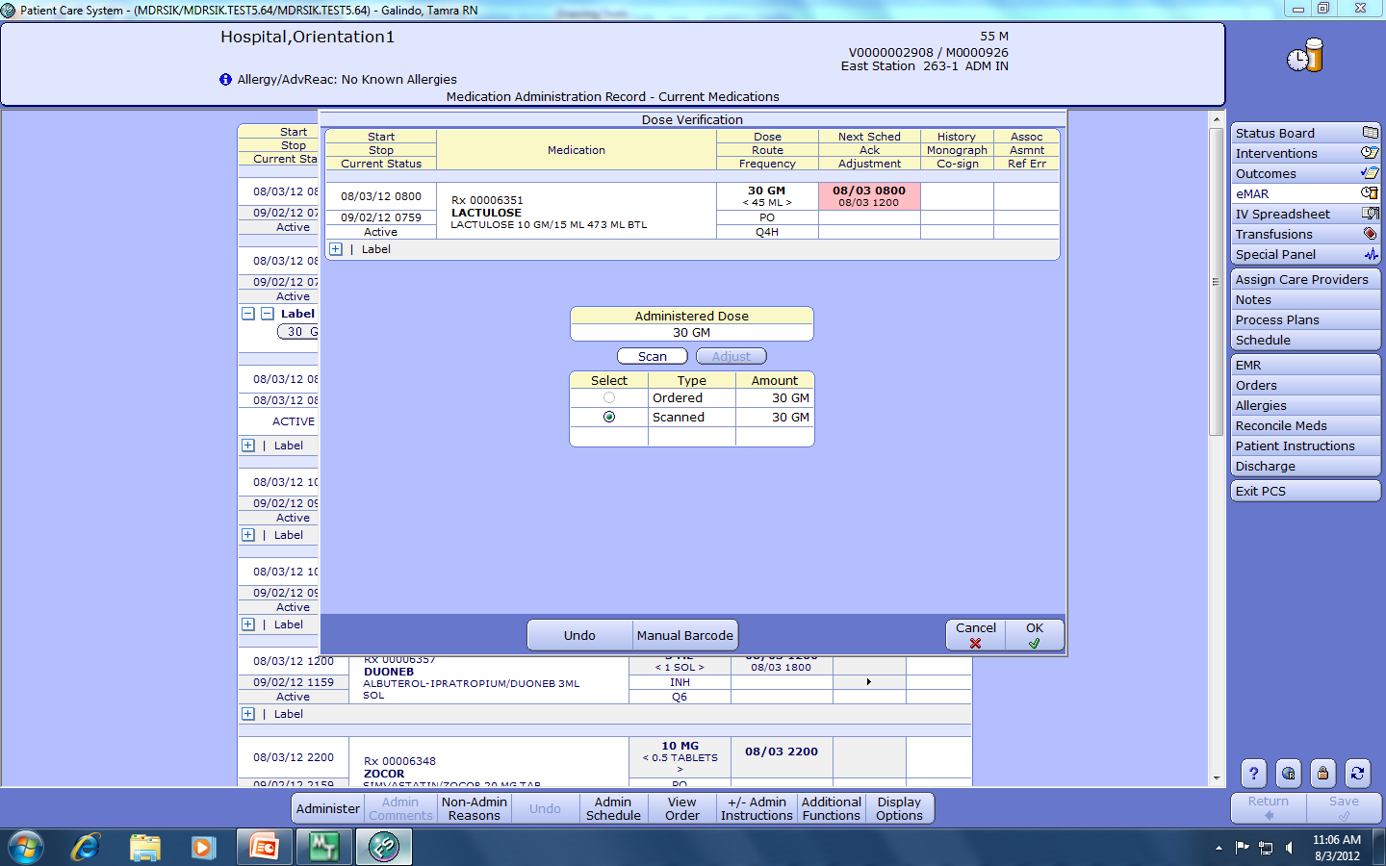
After rescanning the medication two additional times the ordered dose of 30gm has been achieved. Note-the pink color is gone.

Slide 47
This concludes Electronic Documentation/BMV Training For Nursing Students and Instructors
Documentation is very important in health care. Patient safety, including confidentiality must be maintained at all times. Documenting factual, objective information in a timely manner is key to successful documentation.
For questions regarding information in this presentation, please contact
Tammy Galindo MSN/ed, RN
559-675-5486 or tgalindo@maderahospital.org

